Slide 1
Python Basics

Slide 2




Highlights
Example
Question
Notes
Coding Style

Slide 3

Roadmap
Introduction
Objects, Variables, and Data Types
Strings, List and Dictionary
Control Flow Statements

Slide 4



Run! Python, Run!
Installation
Python
Jupyter Notebook (Anaconda)
IDEs (Pycharm/Spyder)

Slide 5
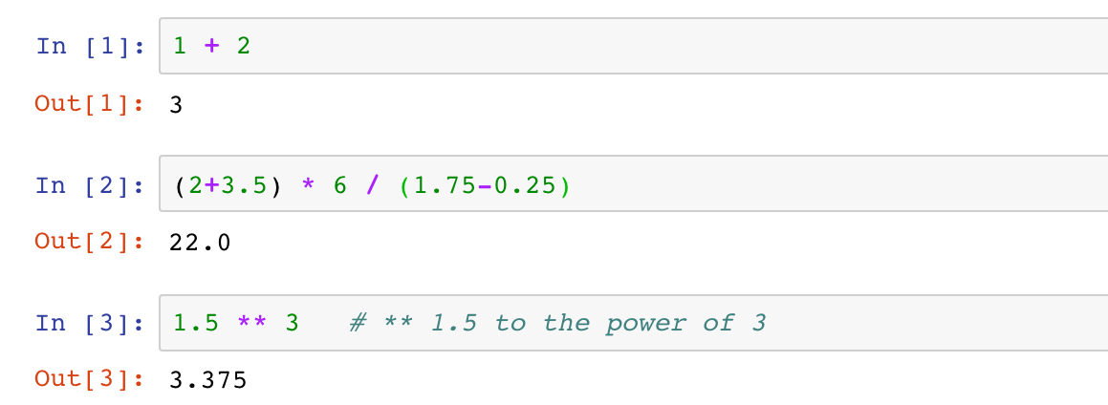
Run! Python, Run!
Interactive Shell Combining Code with Text
Try Python as a scientific calculator
Python arithmetic operators
Python code is executed line by line (cell by cell)

Slide 6

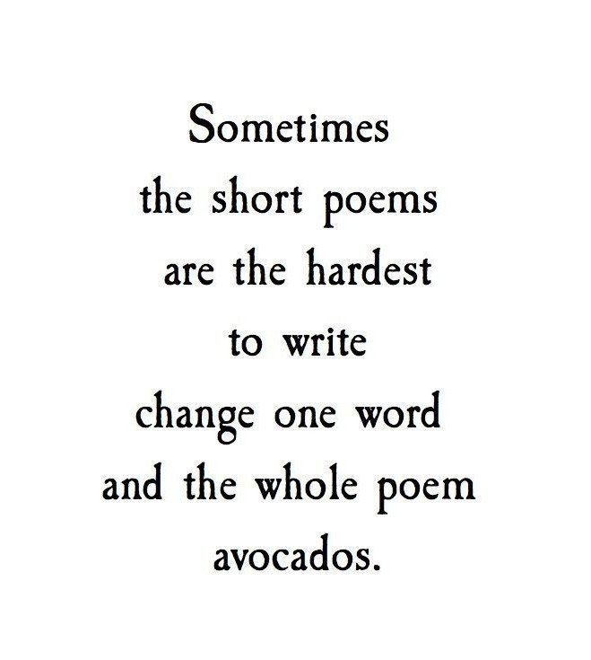


Run! Python, Run!
Interactive Shell Combining Code with text
Try Python as a scientific calculator
Python arithmetic operators
Python code is executed line by line (cell by cell)
Not allowed!!
Notes
Splitting a statement into multiple lines is not allowed.

Slide 7

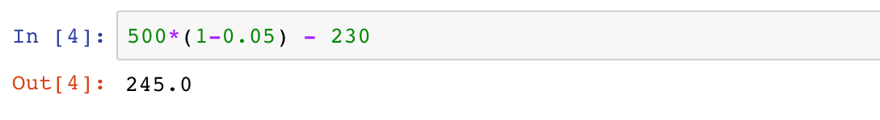
Run! Python, Run!
Interactive Shell Combining Code with Text
Try Python as a scientific calculator
Python arithmetic operators
Python code is executed line by line (cell by cell)
Example 1
A grocery store had 500 packs of cookies in storage. Among the total storage, 5% were dumped due to expiration, and another 230 packs were sold. Calculate how many packs of cookies are left in the grocery store.

Slide 8
Roadmap
Introduction
Objects, Variables, and Data Types
Strings, List and Dictionary
Control Flow Statements

Slide 9

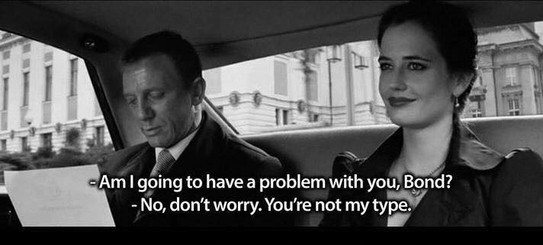
Objects, Variables, and Data Types

Slide 10
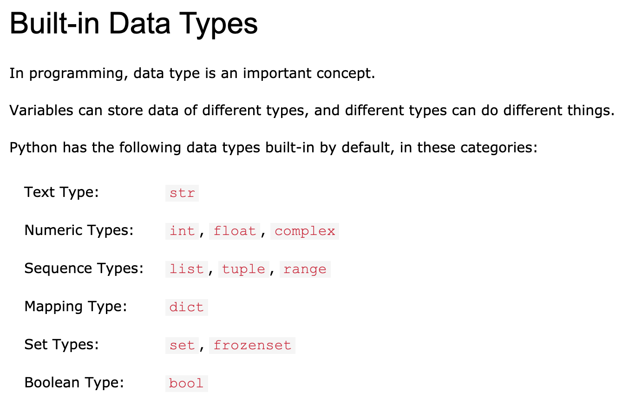
Objects, Variables, and Data Types
An Overview of Datatypes:
https://www.w3schools.com/python/python_datatypes.asp

Slide 11
Objects, Variables, and Data Types
Objects
Almost everything in Python is an object
Every object has a value and a type

Slide 12
Objects, Variables, and Data Types
Variables and Assignment Statements
Variables gives names to objects
Reuse the same value
Improve the readability
Enable control flow

Slide 13

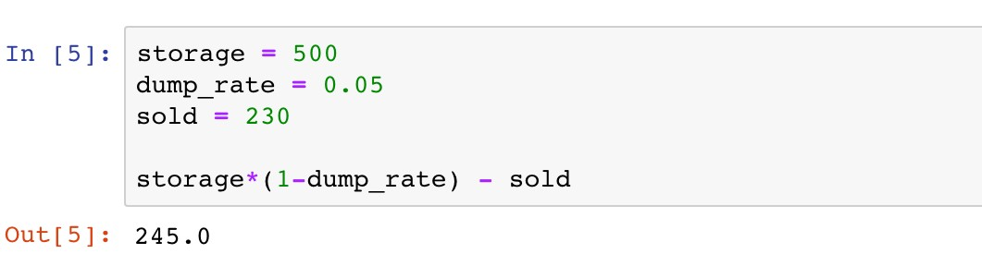
Objects, Variables, and Data Types
Variables and Assignment Statements
The value of a variable can be retrieved by invoking the name
Example 1
A grocery store had 500 packs of cookies in storage. Among the total storage, 5% were dumped due to expiration, and another 230 packs were sold. Calculate how many packs of cookies are left in the grocery store.

Slide 14
Objects, Variables, and Data Types
Variables and Assignment Statements
Assignment operator “="
Example 1
A grocery store had 500 packs of cookies in storage. Among the total storage, 5% were dumped due to expiration, and another 230 packs were sold. Calculate how many packs of cookies are left in the grocery store.

Slide 15
Objects, Variables, and Data Types
Variables and Assignment Statements
Variable(s): name(s) on the left
Example 1
A grocery store had 500 packs of cookies in storage. Among the total storage, 5% were dumped due to expiration, and another 230 packs were sold. Calculate how many packs of cookies are left in the grocery store.

Slide 16


Objects, Variables, and Data Types
Variables and Assignment Statements
Variable(s): name(s) on the left
Example 1
A grocery store had 500 packs of cookies in storage. Among the total storage, 5% were dumped due to expiration, and another 230 packs were sold. Calculate how many packs of cookies are left in the grocery store.
Notes
Only one “word”
Only consist of letters, numbers, and underscores
Cannot begin with a number
Avoid contradictions with Python keywords

Slide 17
Objects, Variables, and Data Types
Variables and Assignment Statements
Value(s): expression(s) on the right
Example 1
A grocery store had 500 packs of cookies in storage. Among the total storage, 5% were dumped due to expiration, and another 230 packs were sold. Calculate how many packs of cookies are left in the grocery store.

Slide 18
Objects, Variables, and Data Types
Variables and Assignment Statements
The value of a variable can be retrieved by invoking the name
Example 1
A grocery store had 500 packs of cookies in storage. Among the total storage, 5% were dumped due to expiration, and another 230 packs were sold. Calculate how many packs of cookies are left in the grocery store.

Slide 19
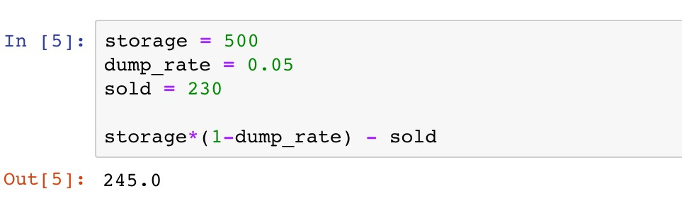
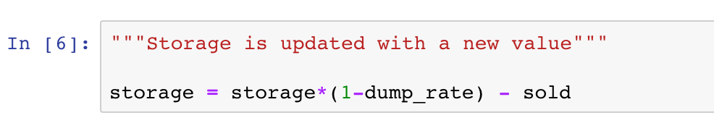
Objects, Variables, and Data Types
Variables and Assignment Statements
Assign new values to variables

Slide 20
Objects, Variables, and Data Types
Variables and Assignment Statements
Assign new values to variables

Slide 21
Objects, Variables, and Data Types
Variables and Assignment Statements
Assign new values to variables
500

Slide 22
Objects, Variables, and Data Types
Variables and Assignment Statements
Assign new values to variables
The new value 245 is assigned as the old one is forgotten

Slide 23


Objects, Variables, and Data Types
Variables and Assignment Statements
Assign new values to variables
Coding Style
PEP 8 Style Guide:
Function and variable names
Whitespace in expressions and statements

Slide 24

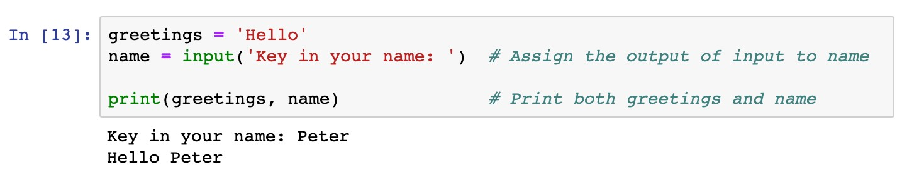
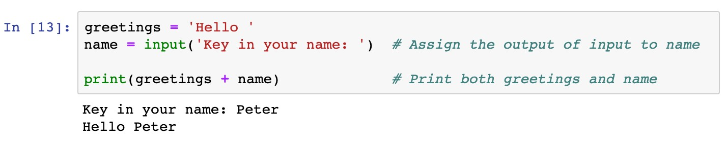
Objects, Variables, and Data Types
Variables and Assignment Statements
Assign values of function outputs to variables
Example 2
Use the “input” function in assignment statements

Slide 25
Objects, Variables, and Data Types
Variables and Assignment Statements
Assign values of function outputs to variables
Example 2
Use the “input” function in assignment statements
Functions: a block of organized, reusable code that is used to perform a single, related action

Slide 26
Objects, Variables, and Data Types
Variables and Assignment Statements
Assign values of function outputs to variables
Example 2
Use the “input” function in assignment statements

Slide 27
Objects, Variables, and Data Types
Variables and Assignment Statements
Assign values of function outputs to variables
Example 2
Use the “input” function in assignment statements
Output of the input function is the text given by users

Slide 28
Objects, Variables, and Data Types
Variables and Assignment Statements
Assign values of function outputs to variables
Example 2
Use the “input” function in assignment statements
Message displayed when users key in the text

Slide 29
Objects, Variables, and Data Types
Variables and Assignment Statements
Assign values of function outputs to variables
Example 2
Use the “input” function in assignment statements

Slide 30

Objects, Variables, and Data Types
Variables and Assignment Statements
Python vs Math
Question
Which assignment statement is correct?
x + y = 2
x * y = 1
2 = x
xy = 2
None of the above is correct

Slide 31
Objects, Variables, and Data Types
Variables and Assignment Statements
Other assignment operations
Operators
Remarks
Examples
+=
Equivalent to x Equivalent to x | = = | x x | + - | y y | x x | += -= | y y
Equivalent to x | = | x | * | y | x | *= | y
Equivalent to x | = | x | / | y | x | /= | y
-=
*=
/=
**=
Equivalent to x
= x**y
x **= y

Slide 32
Objects, Variables, and Data Types
Basic Built-in Data Types
Various types of data may be diﬀerent in nature
Data types determine how functions and operators work
Data types can be retrieved by function
type()

Slide 33
Objects, Variables, and Data Types
Basic Built-in Data Types
Numeric types
: signed integers
int
✓
float
: floating point real numbers
✓
long
and
complex:
long integers and complex numbers (not
covered in this course)

Slide 34
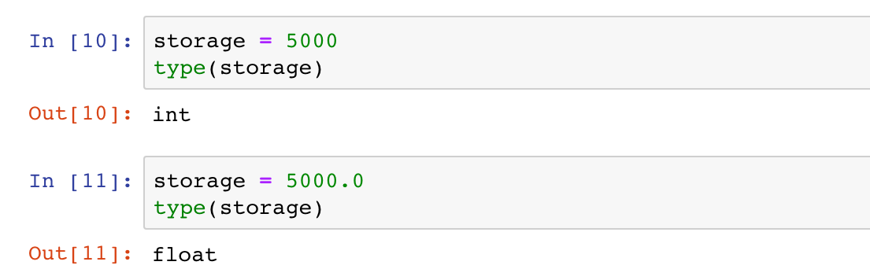
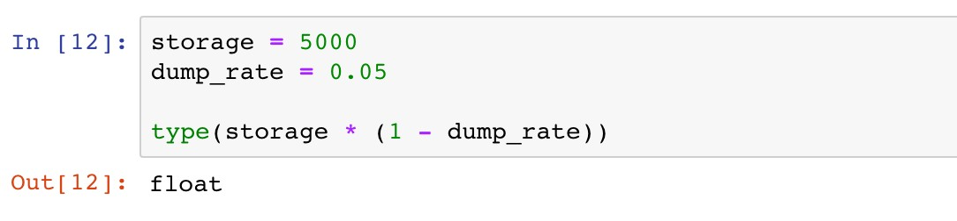
Objects, Variables, and Data Types
Basic Built-in Data Types
Numeric types

Slide 35
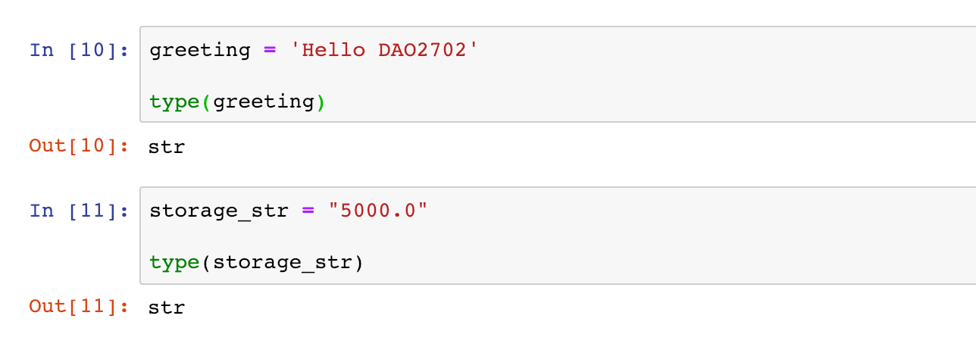
Objects, Variables, and Data Types
Basic Built-in Data Types
String:
str
Single or double quotation marks used in defining strings
Operators and can be used to manipulate strings
+
*

Slide 36

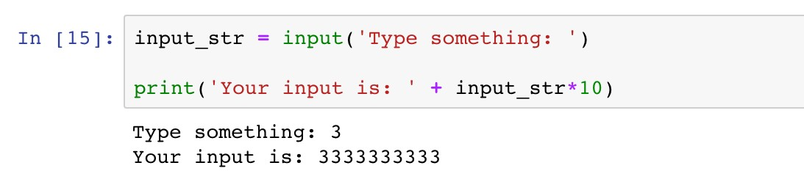
Objects, Variables, and Data Types
Basic Built-in Data Types
String:
str
Example 3
The function “input” enables users to type in a string of characters. Print a message “You input is:”, followed by the input string repeated ten times.
input_str is a string, so “+” combines strings, and “*” replicates strings.

Slide 37

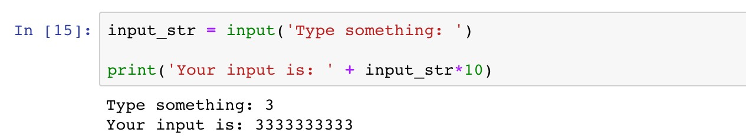
Objects, Variables, and Data Types
Basic Built-in Data Types
String:
str
HOW ABOUT MULTIPLYING THE INPUT NUMBER BY TEN?

Slide 38

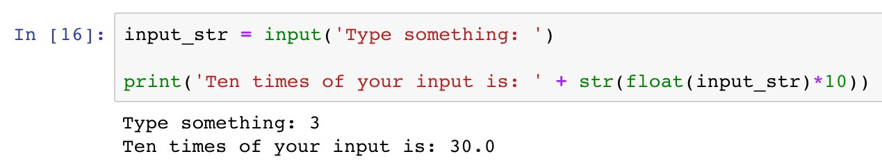
Objects, Variables, and Data Types
Data Type Conversion
Enable manipulating data diﬀerently
Use type name as the conversion function
DATA TYPE CONVERSION!!

Slide 39
Objects, Variables, and Data Types
Data Type Conversion
Enable manipulating data diﬀerently
Use type name as the conversion function
DATA TYPE CONVERSION!!
Convert the string to a floating point number

Slide 40
Objects, Variables, and Data Types
Data Type Conversion
Enable manipulating data diﬀerently
Use type name as the conversion function
DATA TYPE CONVERSION!!
Convert the floating point number back to a string

Slide 41
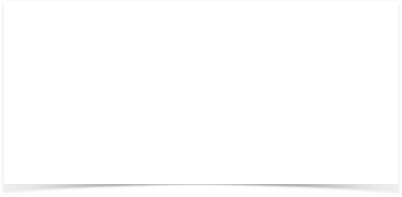
Objects, Variables, and Data Types
Data Type Conversion
BEFORE TYPE CONVERSION

Slide 42

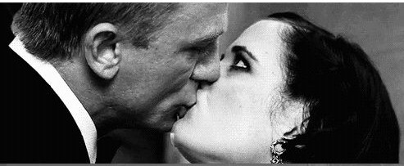
Objects, Variables, and Data Types
Data Type Conversion
BEFORE TYPE CONVERSION
AFTER TYPE CONVERSION

Slide 43

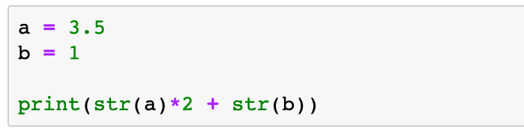
Objects, Variables, and Data Types
Data Type Conversion
Question
What is the output message of the following code?
A. 8
B. 3.53.51
C. 71
D. 3.53.51.0

Slide 44
Roadmap
Introduction
Objects, Variables, and Data Types
Strings, List and Dictionary
Control Flow Statements

Slide 45
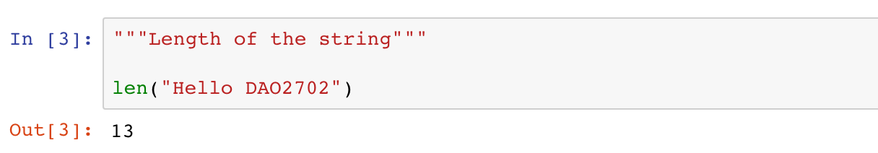
Strings
Strings are collections of characters
Length of a string (the number of characters)
13 characters
H | e | l | l | o |  | D | A | O | 2 | 7 | 0 | 2
0 1 2 3 4 5 6 7 8 9 10 11 12
-13 -12 -11 -10 -9 -8 -7 -6 -5 -4 -3 -2 -1

Slide 46
Strings
Strings are collections of characters
Accessing individual characters
13 characters
H | e | l | l | o |  | D | A | O | 2 | 7 | 0 | 2
0 1 2 3 4 5 6 7 8 9 10 11 12
-13 -12 -11 -10 -9 -8 -7 -6 -5 -4 -3 -2 -1

Slide 47
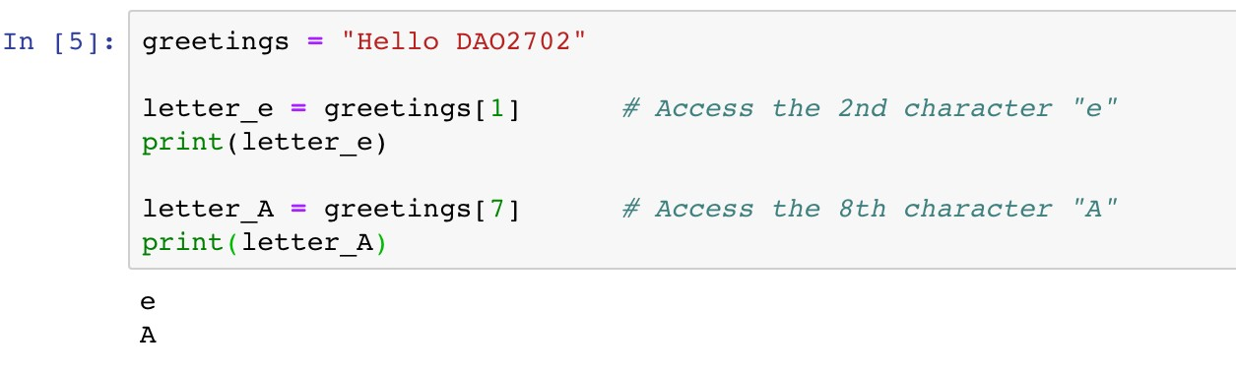
Strings
Strings are collections of characters
Accessing individual characters
13 characters
H |  | l | l | o |  | D |  | O | 2 | 7 | 0 | 2
0 |  | 2 | 3 | 4 | 5 | 6 |  | 8 | 9 | 10 | 11 | 12
e 1
A 7
Index
-13 -12 -11 -10 -9 -8 -7 -6 -5 -4 -3 -2 -1

Slide 48
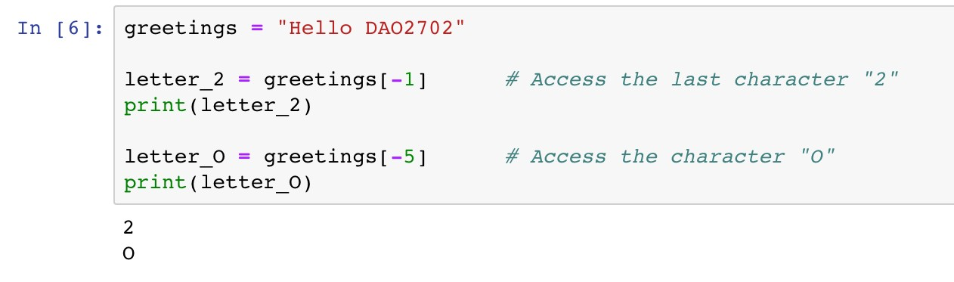
Strings
Strings are collections of characters
Accessing individual characters
13 characters
H | e | l | l | o |  | D | A |  | 2 | 7 | 0
0 | 1 | 2 | 3 | 4 | 5 | 6 | 7 |  | 9 | 10 | 11
-13 | -12 | -11 | -10 | -9 | -8 | -7 | -6 |  | -4 | -3 | -2
O 8
-5
2
12
-1
Index Index from rear

Slide 49
Strings
Strings are collections of characters
Slicing expression: access a subset of a string
13 characters
 |  | D | A | O | 2 | 7 | 0 | 2
 | 5 | 6 | 7 | 8 | 9 | 10 | 11 | 12
 | -8 | -7 | -6 | -5 | -4 | -3 | -2 | -1
H e l l o 0 1 2 3 4
-13 -12 -11 -10 -9
Index Index from rear

Slide 50
Strings
Strings are collections of characters
Slicing expression: access a subset of a string
[start:stop:step]
Arguments | Remarks | Default Values
start | The first index of the slice | 0
stop | The index before which the slice stops | Length of the string
step | The step length of the slice | 1

Slide 51
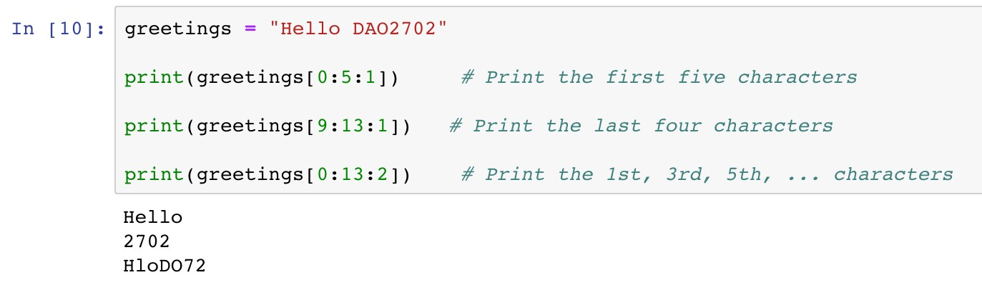
Strings
Strings are collections of characters
Slicing expression: access a subset of a string
13 characters
Index
 |  | D | A | O | 2 | 7 | 0 | 2
 | 5 | 6 | 7 | 8 | 9 | 10 | 11 | 12
H e l l o 0 1 2 3 4
-13 -12 -11 -10 -9 -8 -7 -6 -5 -4 -3 -2 -1
start
stop

Slide 52
Strings
Strings are collections of characters
Slicing expression: access a subset of a string
13 characters
Index
H | e | l | l | o |  | D | A | O
0 | 1 | 2 | 3 | 4 | 5 | 6 | 7 | 8
2 7 0 2
9 10 11 12
-13 -12 -11 -10 -9 -8 -7 -6 -5 -4 -3 -2 -1
start
stop

Slide 53
Strings
Strings are collections of characters
Slicing expression: access a subset of a string
13 characters
Index
 | e |  | l |  |  |  | A |  | 2 |  | 0
 | 1 |  | 3 |  | 5 |  | 7 |  | 9 |  | 11
H 0
l 2
o 4
D 6
O 8
7
10
2
12
-13 -12 -11 -10 -9 -8 -7 -6 -5 -4 -3 -2 -1
start
stop
step

Slide 54
Strings
Strings are collections of characters
Slicing expression
Arguments
Default Values
start 0
Unspecified
stop
Length of the string
step 1
[0:5:1]
[0:5:1]
[:5]
13 characters
Index
 |  | D | A | O | 2 | 7 | 0 | 2
 | 5 | 6 | 7 | 8 | 9 | 10 | 11 | 12
H e l l o 0 1 2 3 4
-13 -12 -11 -10 -9 -8 -7 -6 -5 -4 -3 -2 -1
start
stop

Slide 55

Strings
Strings are collections of characters
Slicing expression
Arguments
Default Values
start
0
Unspecified
stop Length of the string
step 1
[9:13:1]
[9:13:1]
[9:]
[-4:13:1]
[-4:13:1]
[-4:]
13 characters
Index Index from rear
H | e | l | l | o |  | D | A | O
0 | 1 | 2 | 3 | 4 | 5 | 6 | 7 | 8
-13 | -12 | -11 | -10 | -9 | -8 | -7 | -6 | -5
2 7 0 2
9 10 11 12
-4 -3 -2 -1
start
stop

Slide 56
Strings
Strings are collections of characters
Slicing expression
Arguments Default Values
step 1
start 0
Unspecified
stop Length of the string
[0:13:2]
[0:13:2]
[::2]
13 characters
Index
 | e |  | l |  |  |  | A |  | 2 |  | 0
 | 1 |  | 3 |  | 5 |  | 7 |  | 9 |  | 11
H 0
l 2
o 4
D 6
O 8
7
10
2
12
-13 -12 -11 -10 -9 -8 -7 -6 -5 -4 -3 -2 -1
start
stop
step

Slide 57

Strings
Strings are collections of characters
Slicing expression: access a subset of a string
Notes
A common mistake is assuming that the last index of the slice is stop. Please be very careful that the last index should be the last available integer before stop.

Slide 58

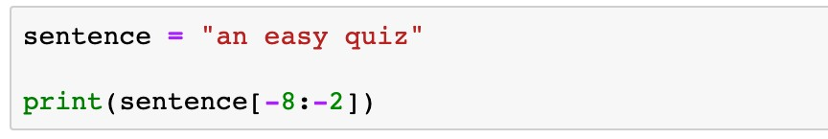
Strings
Strings are collections of characters
Indexing and slicing expression
Question
What is the printed message of the following code?
easy q
easy
asy qu
asy qui

Slide 59
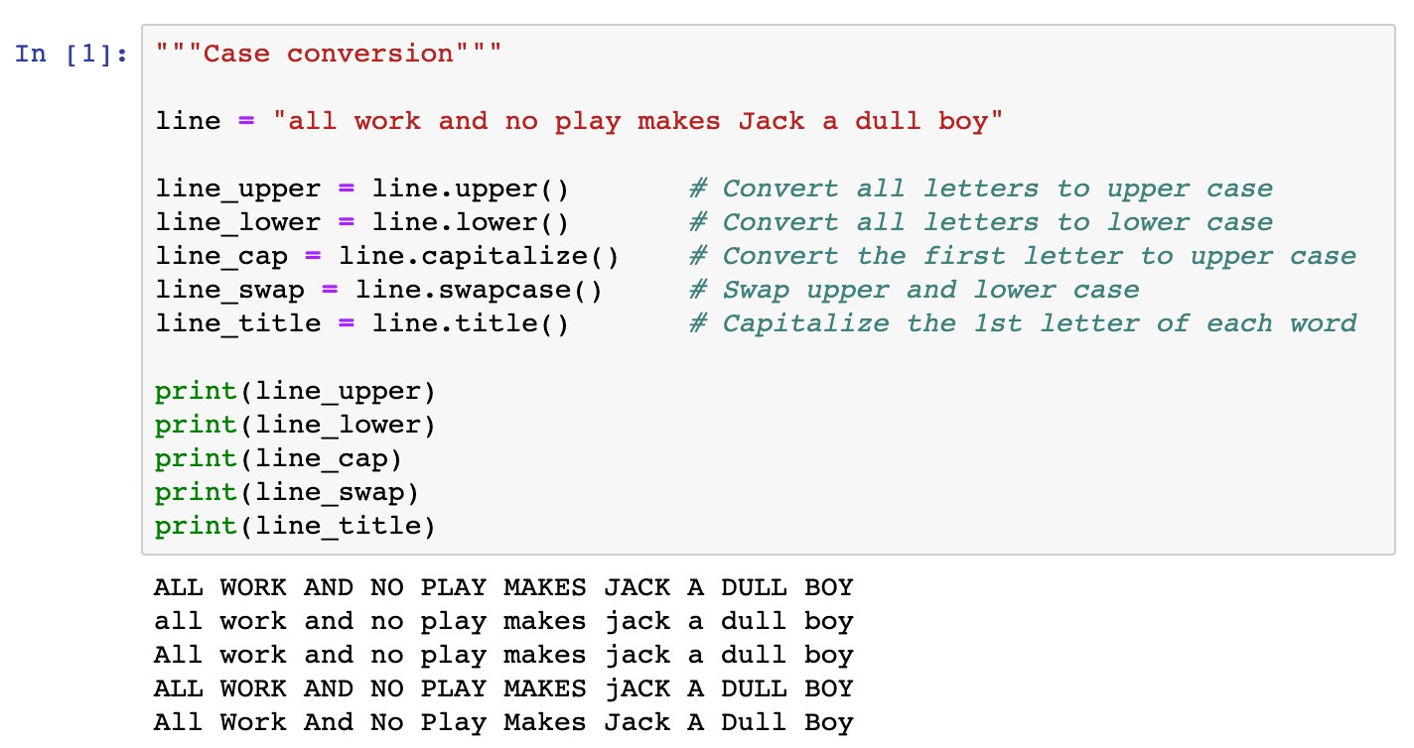
Strings
Methods of strings
Case conversion

Slide 60
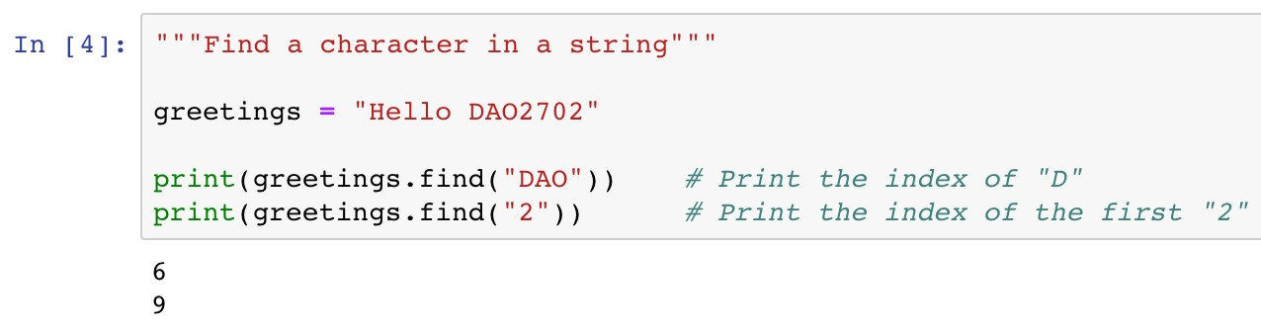
Strings
Methods of strings
Search items in a string
This method returns -1 if the given item cannot be found
13 characters
H | e | l | l | o |  | D | A | O | 2 | 7 | 0 | 2
0 | 1 | 2 | 3 | 4 | 5 | 6 | 7 | 8 | 9 | 10 | 11 | 12
-13 -12 -11 -10 -9 -8 -7 -6 -5 -4 -3 -2 -1

Slide 61
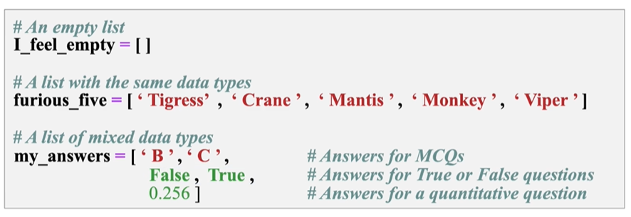
List
List
a collection which is ordered and changeable. Allows duplicate members
0 1 2 3 4 5 6 7 8 9 10 11 12
-13 -12 -11 -10 -9 -8 -7 -6 -5 -4 -3 -2 -1

Slide 62
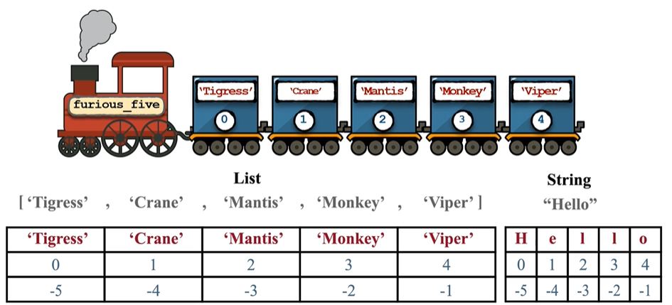
Similarities between list and strings
Similarity: Indexing and slicing
0 1 2 3 4 5 6 7 8 9 10 11 12
-13 -12 -11 -10 -9 -8 -7 -6 -5 -4 -3 -2 -1

Slide 63
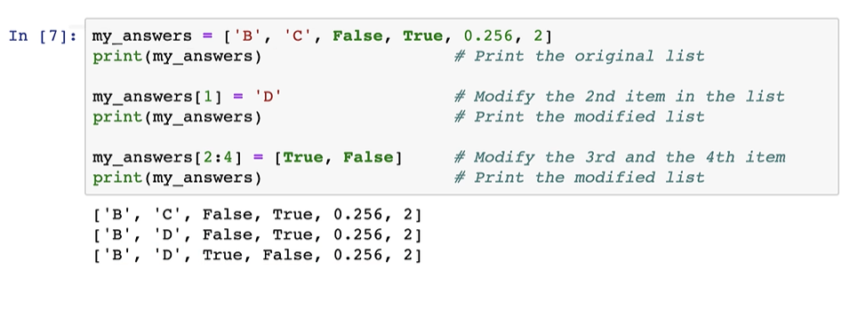
Differences between list and strings
Mutability: element-wise segment
If you try to change some characters in a string via indexing and slicing, an error message will be given!
0 1 2 3 4 5 6 7 8 9 10 11 12
-13 -12 -11 -10 -9 -8 -7 -6 -5 -4 -3 -2 -1

Slide 64
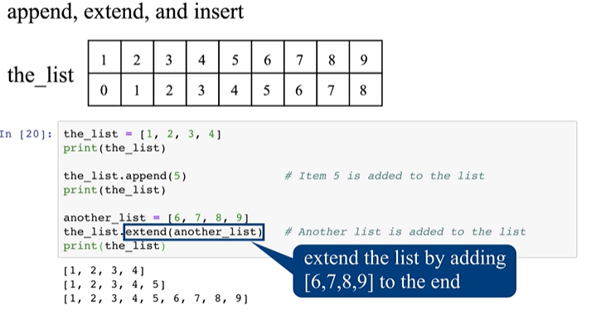
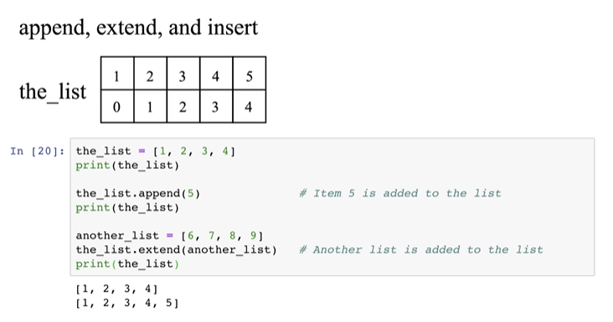
List methods
List
Append, extend a list
0 1 2 3 4 5 6 7 8 9 10 11 12
-13 -12 -11 -10 -9 -8 -7 -6 -5 -4 -3 -2 -1

Slide 65
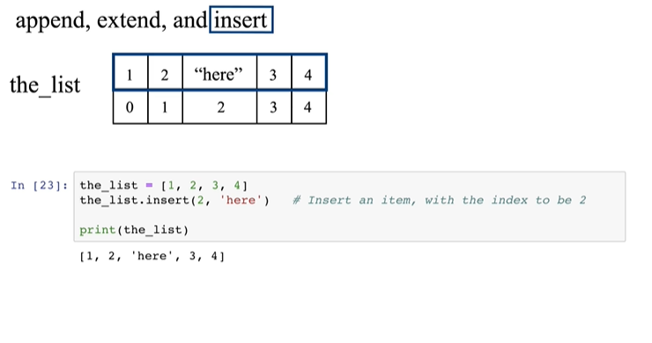
List methods
List
Insert an element to a list
0 1 2 3 4 5 6 7 8 9 10 11 12
-13 -12 -11 -10 -9 -8 -7 -6 -5 -4 -3 -2 -1

Slide 66
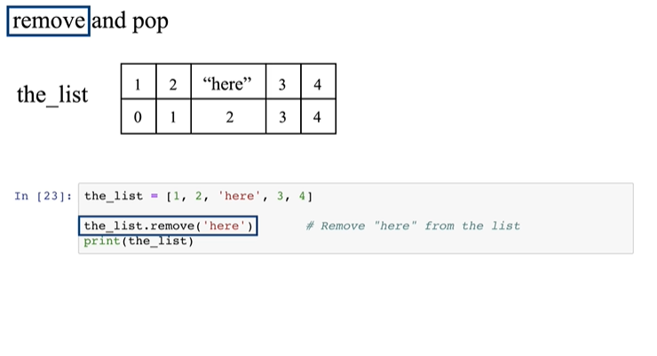
List methods
List
Remove an element from the list using remove()
0 1 2 3 4 5 6 7 8 9 10 11 12
-13 -12 -11 -10 -9 -8 -7 -6 -5 -4 -3 -2 -1

Slide 67
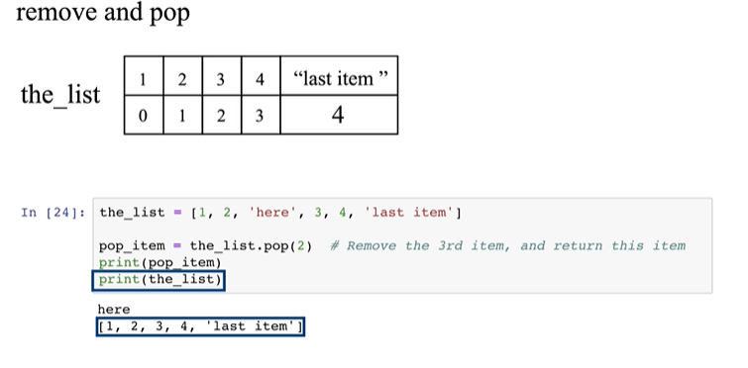
List methods
List
Remove an element from the list using pop()
0 1 2 3 4 5 6 7 8 9 10 11 12
-13 -12 -11 -10 -9 -8 -7 -6 -5 -4 -3 -2 -1

Slide 68
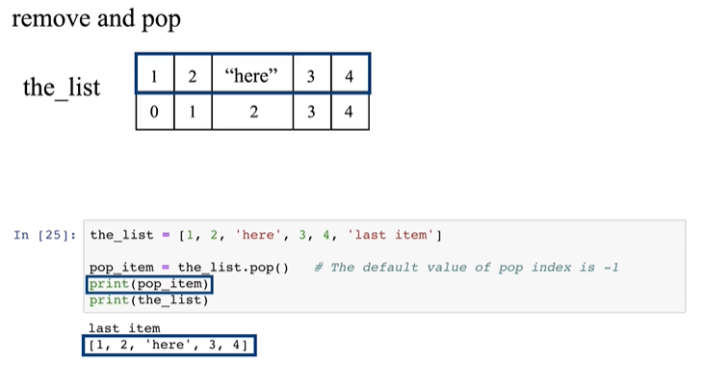
List methods
List
Remove an element from the list using pop()
0 1 2 3 4 5 6 7 8 9 10 11 12
-13 -12 -11 -10 -9 -8 -7 -6 -5 -4 -3 -2 -1

Slide 69
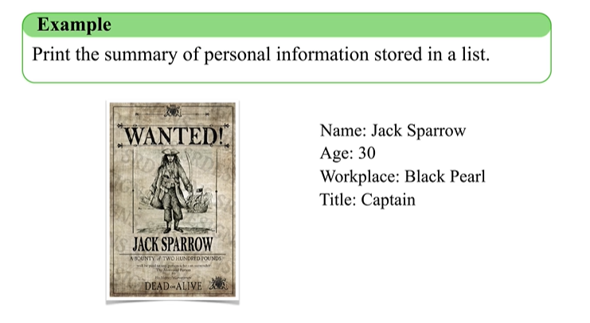
Dictionary
Dictionary
0 1 2 3 4 5 6 7 8 9 10 11 12
-13 -12 -11 -10 -9 -8 -7 -6 -5 -4 -3 -2 -1

Slide 70
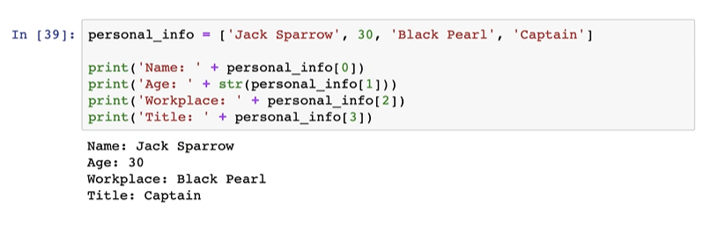
Dictionary
Dictionary
Is this a good method?
0 1 2 3 4 5 6 7 8 9 10 11 12
-13 -12 -11 -10 -9 -8 -7 -6 -5 -4 -3 -2 -1

Slide 71
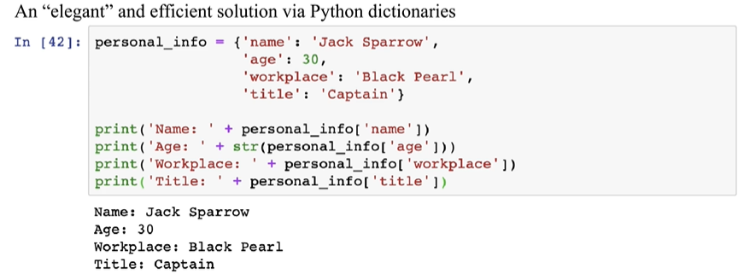
Dictionary
Dictionary
0 1 2 3 4 5 6 7 8 9 10 11 12
-13 -12 -11 -10 -9 -8 -7 -6 -5 -4 -3 -2 -1

Slide 72
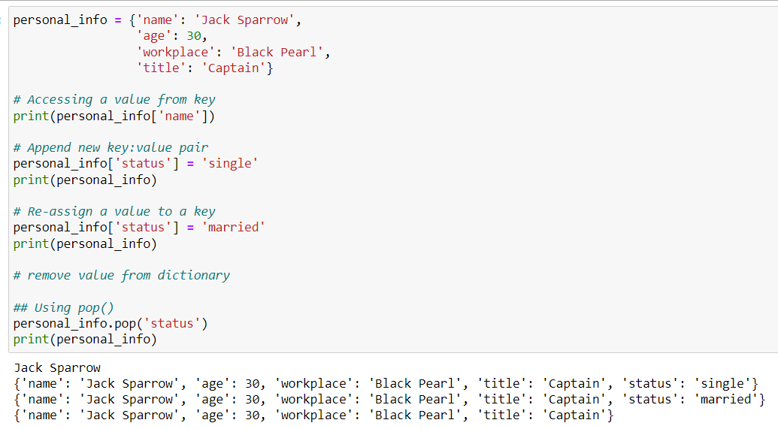
Dictionary
Dictionary
0 1 2 3 4 5 6 7 8 9 10 11 12
-13 -12 -11 -10 -9 -8 -7 -6 -5 -4 -3 -2 -1

Slide 73
Roadmap
Introduction
Objects, Variables, and Data Types
Strings
Control Flow: Boolean Type

Slide 74
Control Flow: Boolean Type
The Boolean Type Expressions
Status:
True
or
False
Comparison operators
Operators
Remarks
Example
==
Equal
Not equal
Greater than or equal to Smaller than or equal to Greater than
Smaller than
x == y x != y x >= y x <= y x > y
x < y
!=
>=
<=
>
<

Slide 75
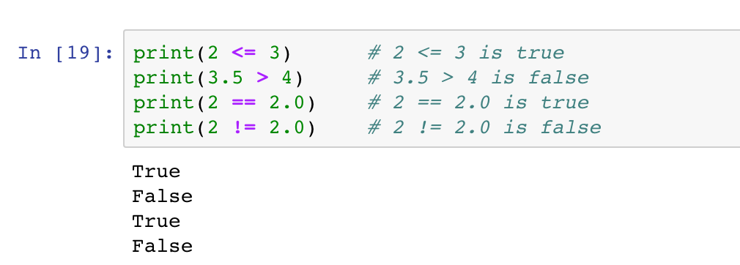
Control Flow: Boolean Type
The Boolean Type Expressions
Status:
True
or
False
Comparison operators

Slide 76
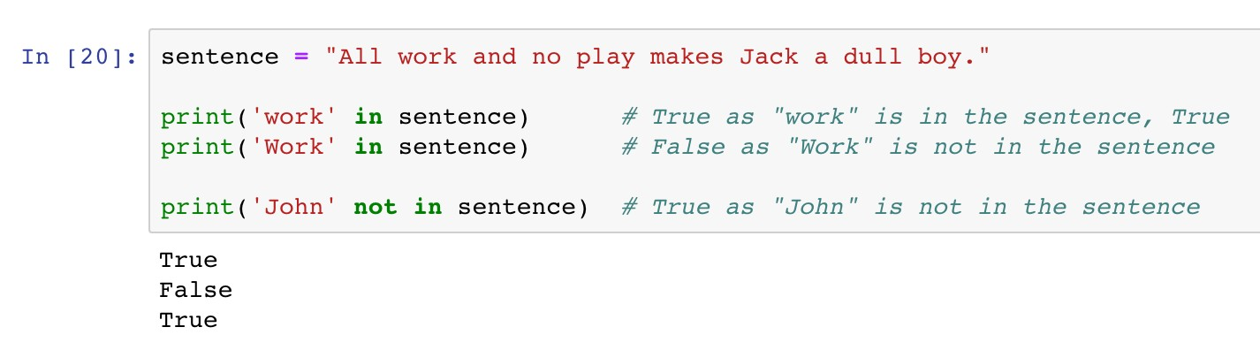
Control Flow: Boolean Type
The Boolean Type Expressions
Status:
True
or
False
Membership operators

Slide 77
Control Flow: Boolean Type
The Boolean Type Expressions
Status:
True
or
False
Logic operators
Operators
Remarks
Examples
x >= 1 and y <= 1
< 1
and
Returns True if
both statements are True
Returns True if either one statements is True
Reverse the result, returns False if the result
or
x > 1 or y
not x == 0
not

Slide 78
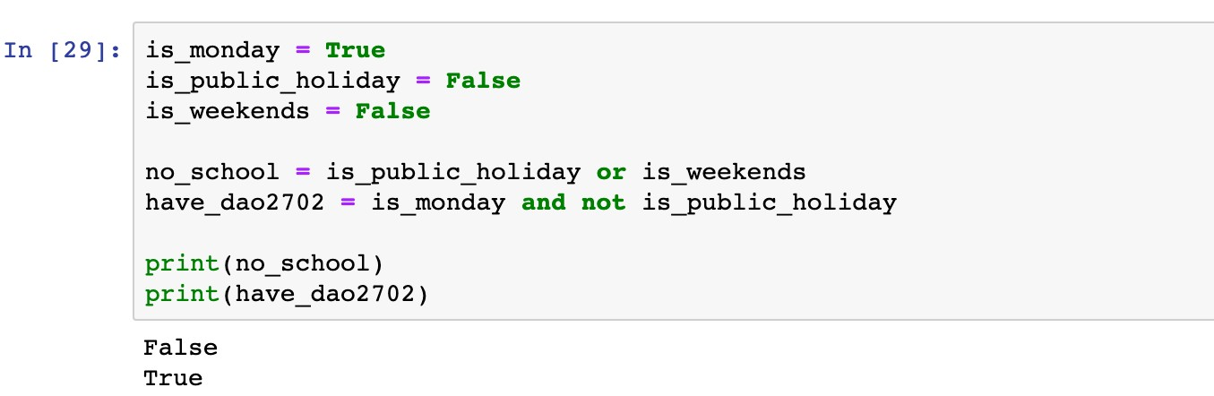
Control Flow: Boolean Type
The Boolean Type Expressions
Status:
True
or
False
Logic operators

Slide 79
Control Flow: Boolean Type
The Boolean Type Expressions
Status:
True
or
False
Logic operators
The condition is True if at least one statement is True

Slide 80
Control Flow: Boolean Type
The Boolean Type Expressions
Status:
True
or
False
Logic operators
The condition is True if both statements are True

Slide 81
Roadmap
Introduction
Objects, Variables, and Data Types
Strings
Control Flow: if

Slide 82
Control Flow: from Boolean Type…
Conditional Statements
The
if-elif-else
syntax enables diﬀerent actions according
to the status of given boolean expressions.

Slide 83
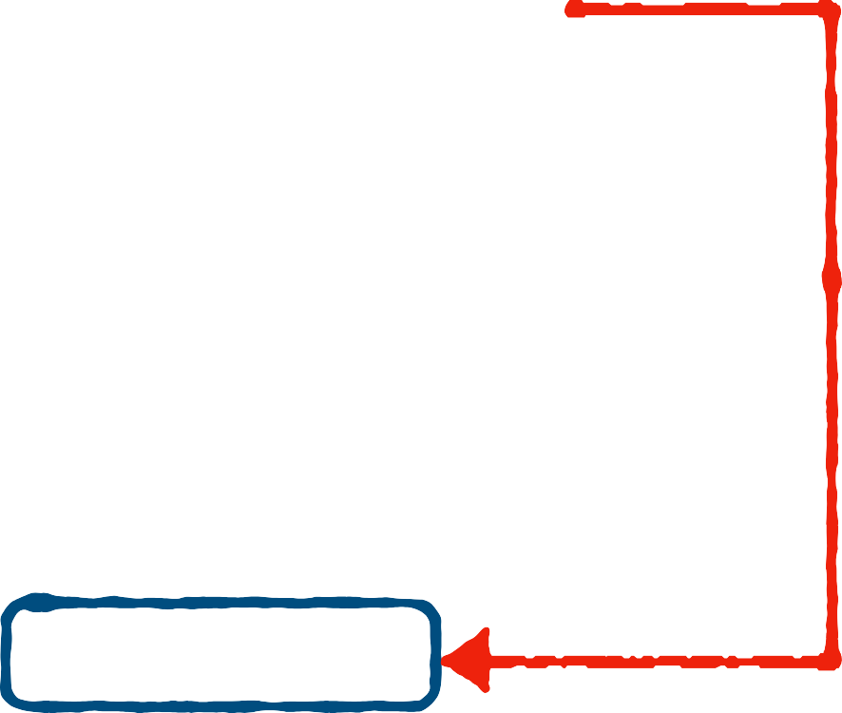

Control Flow: if
Conditional Statements
if
<boolean statement 1>:
<code body 1>
<code body 2>
The
if
syntax
if
Keyword
Execute <code body 1> if
<boolean statement 1> is and skip it if otherwise
Indent (a tab or four spaces)
<code body 1> to diﬀerentiate it from <code body 2>
if
False
<boolean statement 1>:
True
<code body 1>
True,
<code body 2>

Slide 84

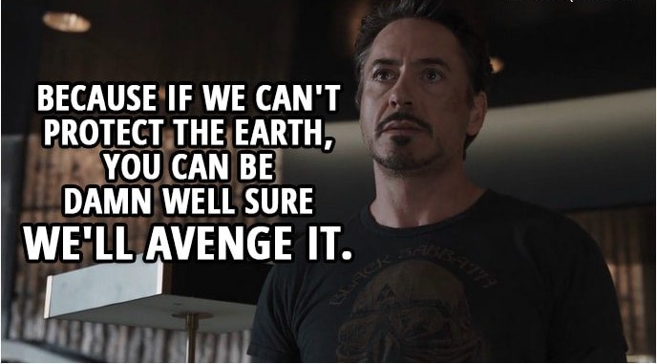
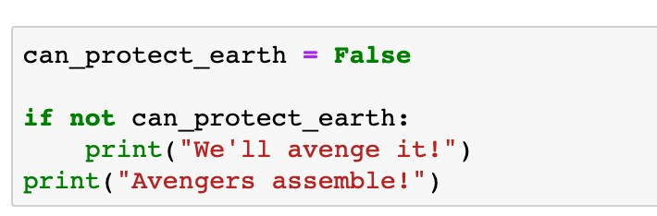
Control Flow: if
Conditional Statements
The
if
syntax

Slide 85
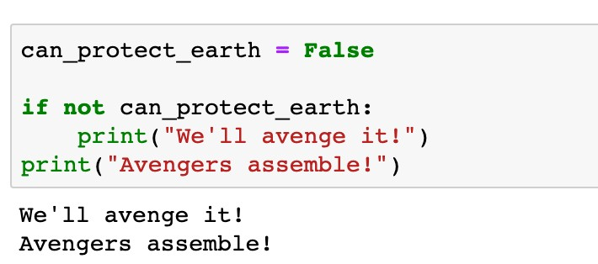
Control Flow: if
Conditional Statements
The
if
syntax

Slide 86
Control Flow: if
Conditional Statements
The
if
syntax
Do not forget the colon
Keyword

Slide 87

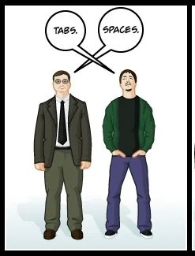
Control Flow: if
Conditional Statements
The
if
syntax
Execute this line if the condition is True
Indentation (a tab or four spaces)

Slide 88
Control Flow: if
Conditional Statements
The
if
syntax
This line is out of the conditional statement

Slide 89
Control Flow: if
Conditional Statements
The
if
syntax
What is the printed message if
is
can_protect_earth
True

Slide 90
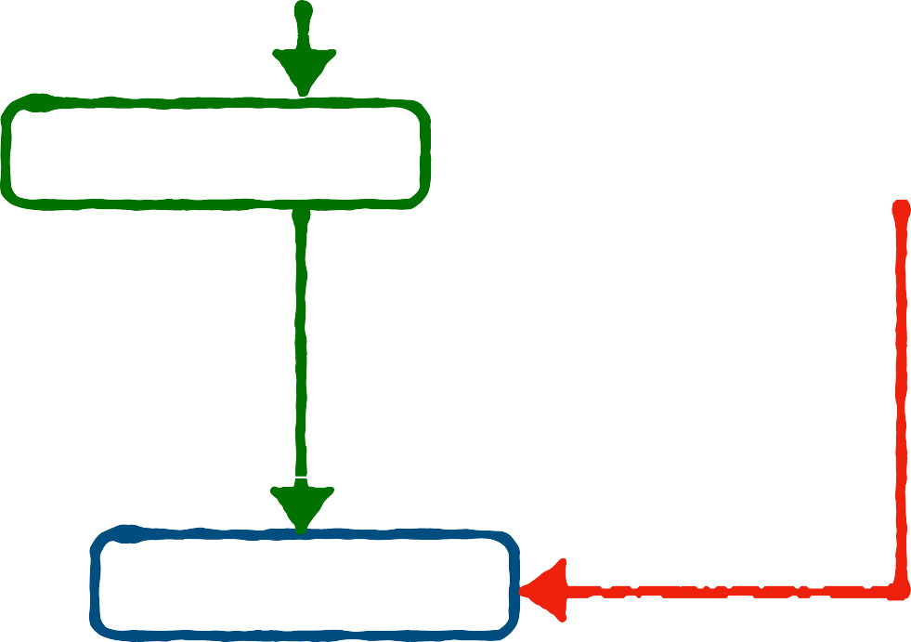
Control Flow: if-else
Conditional Statements
if
<boolean statement 1>:
<code body 1>
:
<code body 2>
<code body 3>
False
<boolean statement 1>:
The
if-else
syntax
else
if
else
Keyword and
Execute <code body 1> if
<boolean statement 1> is
Execute <code body 2> if
<boolean statement 1> is
Same indentations for
if
True
True
<code body 1>
else
: <code body 2>
False
else
<code body 3>

Slide 91
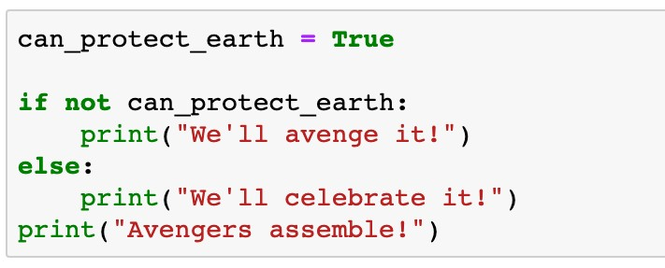
Control Flow: if-else
Conditional Statements
The
if-else
syntax

Slide 92
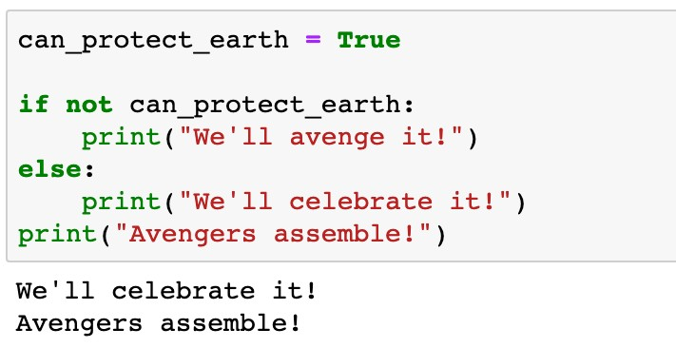
Control Flow: if-else
Conditional Statements
The
if-else
syntax

Slide 93
Control Flow: if-else
Conditional Statements
The
if-else
syntax
Execute this line if the condition is False
Indentation (a tab or four spaces)

Slide 94




Control Flow: if-elif-else
Conditional Statements
if
<boolean statement 1>:
<code body 1>
The
if-elif-else
syntax
elif
: <boolean statement 2>:
<code body 2>
Keyword elif to add more conditions
else
:
<code body 3>
<code body 4>
False
<boolean statement 1>:
if
True
<code body 1>
elif
<boolean statement 2>:
False
True
<code body 2>
else
: <code body 3>
<code body 4>

Slide 95
Roadmap
Introduction
Objects, Variables, and Data Types
Strings
Control Flow: while

Slide 96


Control Flow: while
Iterations and loops
while
<boolean statement>:
<code body to be repeated>
<other code>
The
while
loop
while
Keyword
Check the status of
<boolean statement> in each iteration
Repeatedly Execute <code to be repeated> if <boolean statement> is
Same indentations for
<code to be repeated>
while
False
<boolean statement>:
True
<code to be repeated>
True
<other code>

Slide 97


Control Flow: while
Iterations and loops
The
while
loop

Slide 98



Control Flow: while
Iterations and loops
The
while
loop
Example 1
In the movie Dr. Strange (2016), Steven Strange beat the supervillain "Dormammu" by keeping annoying him until he was extremely bored and frustrated. Write a program to act like Dr. Strange. The "time" loop can only be broken when you type in "I quit" or "You win".
False
<boolean statement>:
True
<code to be repeated>
while
<other code>

Slide 99


Control Flow: while
Iterations and loops
The
while
loop
Example 1
In the movie Dr. Strange (2016), Steven Strange beat the supervillain "Dormammu" by keeping annoying him until he was extremely bored and frustrated. Write a program to act like Dr. Strange. The "time" loop can only be broken when you type in "I quit" or "You win".
False
Dormammu not quit:
True
I’ve come to bargain What does Dormammu say?
Movie ends
while

Slide 100

Control Flow: while
Iterations and loops
The
while
loop
Example 1
In the movie Dr. Strange (2016), Steven Strange beat the supervillain "Dormammu" by keeping annoying him until he was extremely bored and frustrated. Write a program to act like Dr. Strange. The "time" loop can only be broken when you type in "I quit" or "You win".

Slide 101


Control Flow: while
Iterations and loops
while
False
Dormammu not quit:
The
while
loop
True
I’ve come to bargain What does Dormammu say?
Movie ends
Check the condition in each iteration
Indentation
Loop body

Slide 102
Control Flow: while
Iterations and loops
while
False
Dormammu not quit:
The
while
loop
True
I’ve come to bargain What does Dormammu say?
Movie ends
An inner conditional statement to check if Dormammu quits

Slide 103
Control Flow: while
Iterations and loops
while
False
Dormammu not quit:
The
while
loop
True
I’ve come to bargain What does Dormammu say?
Movie ends
Extra Indentation
Extra Indentation
Execute if the boolean condition is True
Execute if the boolean condition is False

Slide 104
Control Flow: while
Iterations and loops
while
False
Dormammu not quit:
The
while
loop
True
I’ve come to bargain What does Dormammu say?
Movie ends
True
Change the boolean status to stop the loop

Slide 105

Control Flow: while
Iterations and loops
The
while
loop
Example 1
In the movie Dr. Strange (2016), Steven Strange beat the supervillain "Dormammu" by keeping annoying him until he was extremely bored and frustrated. Write a program to act like Dr. Strange. The "time" loop can only be broken when you type in "I quit" or "You win".

Slide 106


Control Flow: while
Iterations and loops
while
True:
The
while
loop
True
I’ve come to bargain
if Dormammu says “quit” ?
True
break
Movie ends
Always True
Indentation
Loop body

Slide 107
Control Flow: while
Iterations and loops
while
True:
The
while
loop
True
I’ve come to bargain
if Dormammu says “quit” ?
True
break
Movie ends
Stop the loop immediately

Slide 108
Control Flow: while
Iterations and loops
The
while
loop
while
Keyword
Indentations for the code block to be repeated
Stoping criterion
Indefinite iterations (unknown number of iterations)

Slide 109
Roadmap
Introduction
Objects, Variables, and Data Types
Strings
Control Flow: for

Slide 110


Control Flow: for
Iterations and loops
The
for
loop
for
<item> in <sequence>:
<code body to be repeated>
<other code>
for
in
Keywords and
In each iteration, <item> takes one value from
<sequence>
The number of iterations is the number of values in <sequence>
Same indentations for
<code to be repeated>
for
<item>
in
<sequence>:
<item> takes one value
<code to be repeated>
Loop stops
<other code>

Slide 111

Control Flow: for
Iterations and loops
The
for
loop
Example 2 Cheerleader chant
for
<item>
in
<sequence>:
<item> takes one value
<code to be repeated>
Loop stops
<other code>

Slide 112


Control Flow: for
Iterations and loops
for
in
letter name:
letter takes each letter
Shout out each letter
The
loop
Loop stops
for
Example 2 Cheerleader chant
Go! Go!

Slide 113

Control Flow: for
Iterations and loops
The
for
loop
If letter is a whitespace
Skip the subsequent code and continue to the next iteration
Extra Indentation

Slide 114




Control Flow: for
Iterations and loops
for
in
letter name:
letter takes each letter
Shout out each letter
The
for
loop
Loop stops
Take each letter from name in each iteration
Go! Go!
Indentation
Loop body

Slide 115
Control Flow: for
Iterations and loops
The
for
loop
name
J | a | c | k
Take each letter from name in each iteration
Indentation
Loop body

Slide 116
Control Flow: for
Iterations and loops
The
for
loop
name
J | a | c | k
1st iteration
letter
Take each letter from
name in each iteration
Indentation
Loop body

Slide 117
Control Flow: for
Iterations and loops
The
for
loop
name
J | a | c | k
2nd iteration
letter
Take each letter from
name in each iteration
Indentation
Loop body

Slide 118
Control Flow: for
Iterations and loops
The
for
loop
name
J | a | c | k
3rd iteration
letter
Take each letter from
name in each iteration
Indentation
Loop body

Slide 119
Control Flow: for
Iterations and loops
The
for
loop
name
J | a | c | k
4th iteration
letter
Take each letter from
name in each iteration
Indentation
Loop body

Slide 120
Control Flow: for
Iterations and loops
Comparison between
while
for
loop
loop
Definite iteration
A counter is updated through the loop
loop and
while
loop
for
Indefinite iteration
A counter can be defined and manually updated
Break the loop by
break
Skip the code by
continue

